Slide 1

Industrial Internet Of Things, Oil and Gas industry.
Prepared by Musa and Friends

Slide 2

Overview of Oil and Gas Industry
Oil and Gas is a multibillion-dollar industry because the product they possess has a high demand.
Oil and natural gas are necessary resources. E.g crude Oil
Getting the crude out of the ground is one thing, but once it’s out, it must be moved to refineries and ultimately to the pump.
Important use includes plastic, clothing, car and many more

Slide 3

HOW DOES IIOT CONTRIBUTE TO THE O&G INDUSTRY?
The IoT is a network of intelligent computers, devices, and objects that collect and share huge amounts of data.
The application of the IoT to the manufacturing industry is called the IIoT .
Several innovative companies have started to implement the IIoT by leveraging intelligent, connected devices in their factories.
However, oil and gas companies have been slow to adopt technological innovations on the software front
Many of the reasons are understandable; the capital that was once plentiful has seen a rapid decline and the industry is stuck in the "old way" of doing things

Slide 4
top technologies adopted in other industries but slow to integrate into the oil and gas industry
Robotics
Artificial Intelligence
Cloud computing

Slide 5
IoT devices
IoT involves extending internet connectivity beyond standard devices, such as desktops, laptops..to any range of traditionally dumb or non-internet-enabled physical devices and everyday objects.
Khaleel and Pilar (2018, p. 25) mention that authors recommend a model for a smart university, which is consisted of utilizing sensor devices in the five main categories namely Environment sensors used to detect noise, temperature and lightening, Security sensors for motion detection, opening/closing doors or windows and fingerprints, Safety sensors to detect smoke, fire, and water, Utilitarian sensors for electrical voltages and NFC tags and Information sensors for RFID cards, QR tags, and barcodes

Slide 6
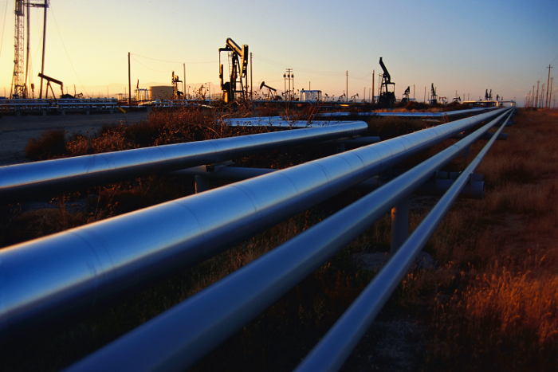
IIOT TRANSPORTATION IN GAS AND OIL INDUSTRY
How does the gas reach the filling station at your area?
Probably a remote offshore oil well, traveling hundreds more miles in a pipeline across intense desert terrain.
Carried by train and truck until finally arriving at your local filling station. Along the way, they passed through countless pumps, holding tanks, meters, monitors and hoses.
What happens if there is a leak?!

Slide 7
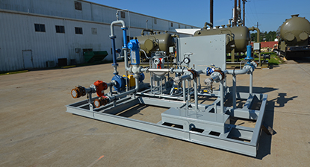
LACT units Integration with Sensors
One crude oil is out, it is moved to refineries and to the pump.
This is a vast network of ships, barges, pipelines, trains and trucks crisscrossing the globe.
At nearly every intersecting point in this network, there is a piece of equipment familiar to those in the industry that most people would never think about: The so-called “skids” that measure the amount of product transferred from one container to another as it changes hands.
Known as Lease Automatic Custody Transfer (LACT) units, these skids have historically been just one of thousands of assets scattered around the world and often located in the middle of nowhere. Doing their jobs in isolation with no connectivity, skids have traditionally relied on paper-based processes and periodic site visits for routine maintenance, leaving them vulnerable to inaccuracies and failures
— until a company called Trigg Technologies changed that with the help of Rockwell Automation and Microsoft.
By modernizing LACT units with sensors and moving that information to the cloud with Azure, Trigg Technologies has enabled its skids for remote service and maintenance, including the ability to monitor the product being transferred to ensure it is correct, and coordinate immediate electronic invoicing.

Slide 8
BUILDING A SMARTER GAS PUMP
Rockwell Automation and its partners, work to install fueling lanes and to connect and cloud enable new pumps.
Cloud gateway appliances at each station collect the data and securely send it to a cloud platform provided by Rockwell Automation.
Collecting and storing real-time data from hundreds of sensors, variable frequency drives and Rockwell Automation’s control systems allows each of the stakeholders across their supply chain to perform their function more efficiently. Leaks can be detected in real time

Slide 9
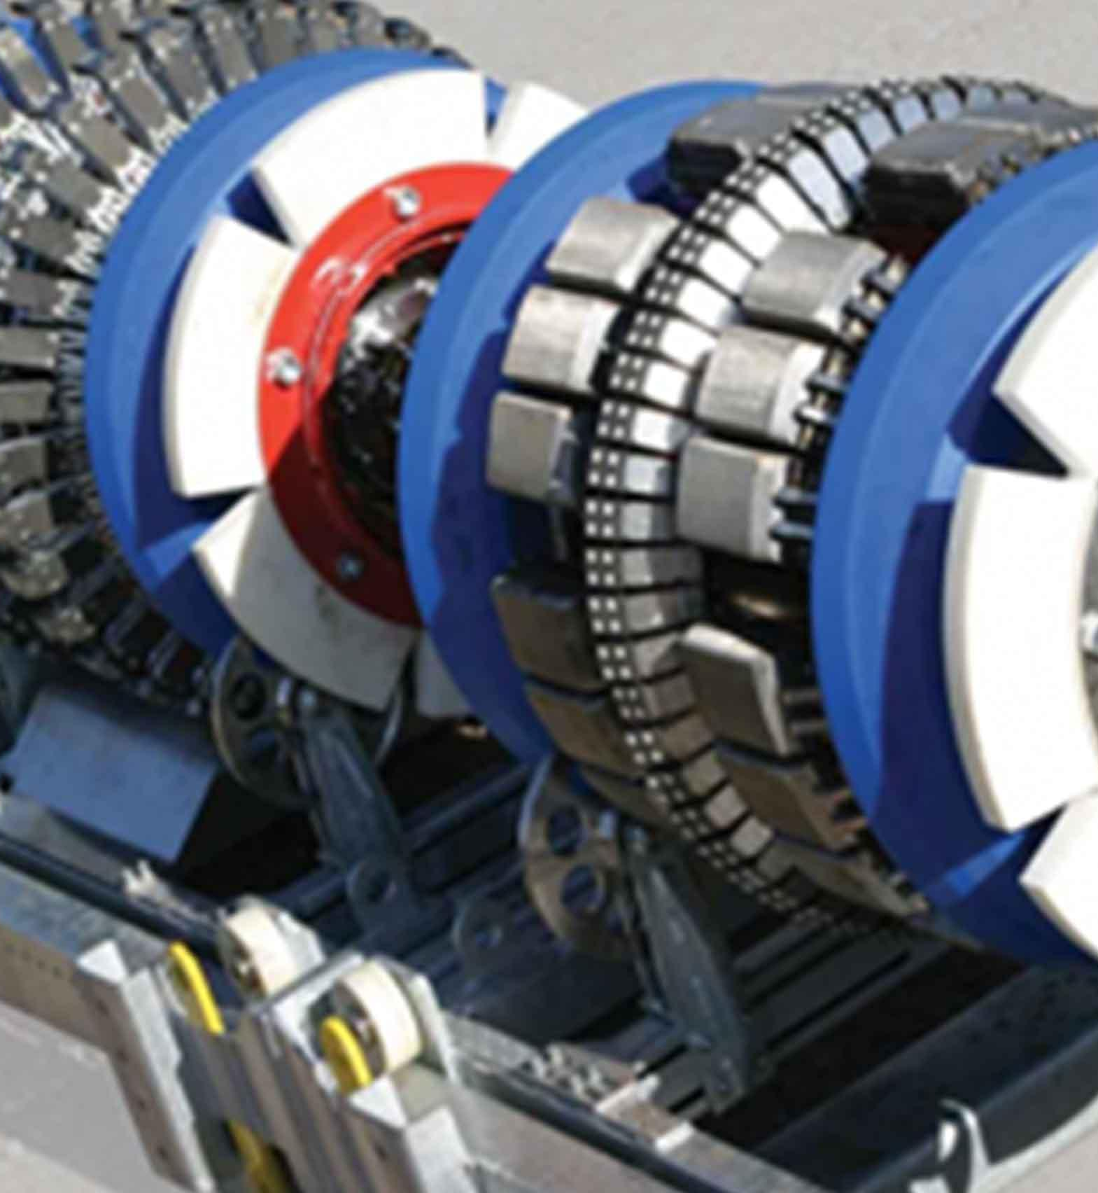
The robotic instrument called smart pig
The pipelines are mostly coated steel pipe buried underground. Oil pipelines typically transport liquid at pressures between 600 and 1000 psi, while natural gas pipelines go up to 1500 psi (per square inch).
These high pressures are why ruptures can be so serious, and why monitoring and detecting flaws in advance is so important, particularly given the age of some of these pipes.
It is only when there is a leak in pipelines the public tend to be conscious, leading to a toxic spill, or even an explosion that costs lives.
Alex Jablokow(2015, p) mentions that the industry has started the incorporation of sensing technologies to monitor the pressure, flow compressor condition, density, temperature and other variables

Slide 10
Model for IoT Implementation
In order to be predictive and proactive in management of network of Pipelines.
Mel Christopher, propose these models for IoT implementation
Situational awareness creates intelligence out of the data, with better visualizations that enable operators in the Gas Control Center to see changes in the system quickly.
Situational intelligence follows, and integrates geospatial and temporal data to give a precise understanding of specific events as they happen.
Predictive analytics finally take all of that real-time data and pull out patterns that signal approaching abnormal events, allowing for proactive responsiveness.

Slide 11

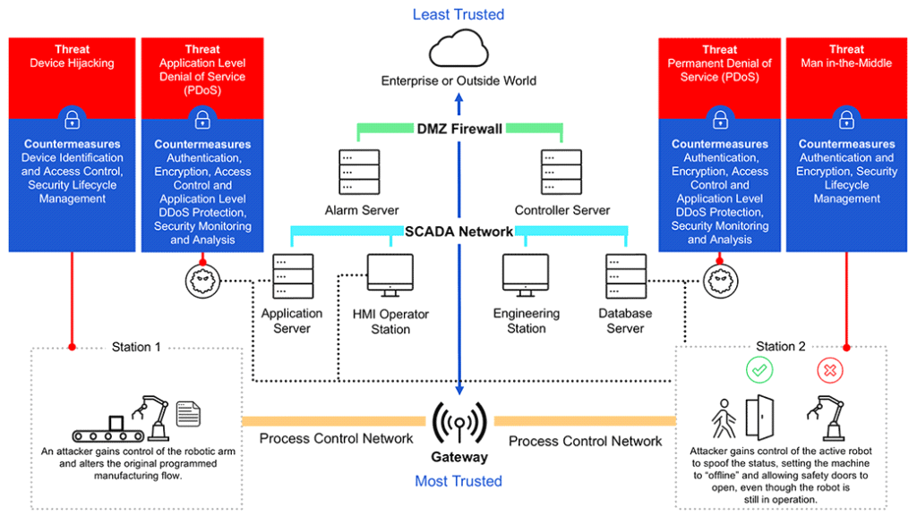
SAFETY AND SECURITY ISSUES OF IIOT

Slide 12
Known Threats
Man-in-the Middle
happens when an attacker manages to breach, interrupt or spoof communicational links between two or more systems.
Device Hijacking
happens when the attacker hijacks and assumes control of a device effectively so as holistically.
Distributed Denial of Service
render a machine or network resource to be unavailable to the inteded users by distrupting services of a host

Slide 13
Countermeasures and Preventations
i) Firmware robustness and assured boot
The secure boot has to apply cryptographic signing techniques
Stop hackers from substituting firmware with malevolent instruction sets
ii) Reciprocal authentication
Assure the data is coming from a legitimate source
iii) Assured Communicational Link (end-to-end encryption)
Secure data transit between an appliance and its amenities

Slide 14
C
o
n
c
l
u
s
i
o
n
-The IIoT concepts have transformed the O & G Industry business model dramatic and thoroughly
-Furthermore, the cost of connected sensors gradually plummeted, leapfrogging the digitization programs
- Briefly, involving in IIoT technology requires the O & G Industry to prioritize the safety and security of the connected smart devices so as to shoo off the attackers from breaching into the servers to attain confidential data
- Example of attacks ; Man-in-the Middle and Device Hijacking
-Therefore, appropriate countermeasures should be set up to combat the threats

Slide 15
Q & A
Thanks for your attention and not sleeping :)

